Slide 1
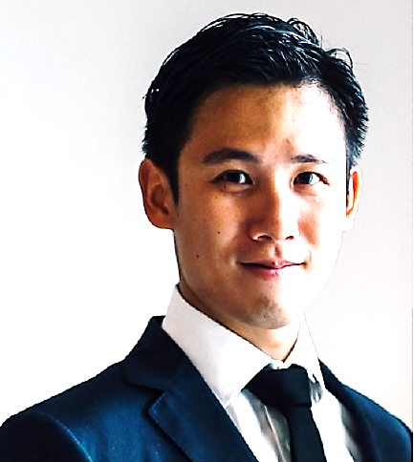
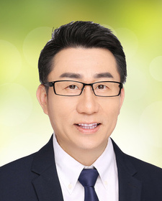
Regional Readiness Webinar Series: Working in China
Mr Neo Weisheng Mr Wesley Hui
Investor at Qualgro VC Founder of WiseNet Asia
Discover the Working Culture and Business Etiquette in China!
Gain insights on how a Singaporean worked in Alibaba Group and led projects to help startups engage with the Alibaba ecosystem!
We would like to invite all students to join us for this webinar.
In this webinar, you will:
Discover the working culture and business etiquette in China
Learn more about our 2021 virtual OIWSP opportunities
Gain insight into Mr Neo Weisheng’s role as a Global Leadership
Associate at Alibaba Group
Have a LIVE interactive Q&A with our speakers
Date: 26 March, Friday
Time: 10:00am – 11:30am
Mode: Virtual (Zoom)
Due to limited spots, this event is by invitation only and successful applicants will be notified with
event details by 25 March via the email address indicated on your application.

